Slide 1
Agenda
Session I
Distributed DNN training overview
When the network is the bottleneck
SwitchML: In-network aggregation
SwitchML hands-on
Training with SwitchML
SwitchML API
Session II
OmniReduce: Sparse collective communication
OmniReduce hands-on
GRACE: Gradient compression
GRACE hands-on
Implement and run a gradient compression algorithm

Slide 2


A closer look at model synchronization
W₁
W₂
W₃
W₄
If only I could help…
Distributed ML scales poorly due to communication costs
Switch

Slide 3
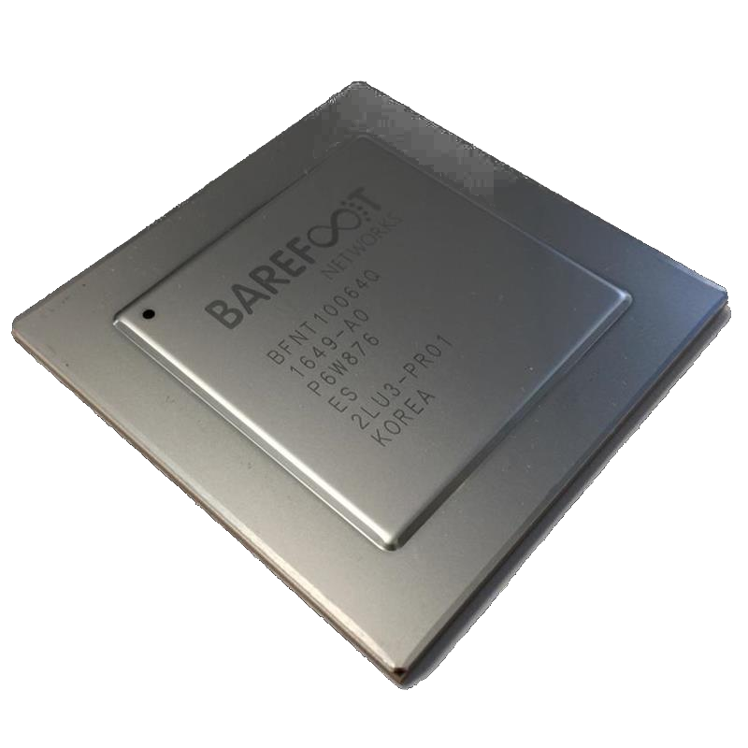
Programmable data plane
100 Gbps line rate processing
6.5 Tbps
Notes:
we considered programmable dataplanes, which are new networking ASICs that can process Tb of traffic per second, while also providing significant flexibility on how the traffic must be processed.

Slide 4

SwitchML: In-network aggregation
SwitchML performs data aggregation along network paths using programmable network devices
Offloads aggregation to switches:
reduces traffic on the network fabric
reduces the amount of work at end hosts
improves overall training time
performs aggregation at “sub-RTT” latency
Other collectives can be supported
Broadcast, Barrier, Allgather, Reduce, ReduceScatter, …
∑

Slide 5



SwitchML: Co-design ML and networking
Challenges
Design
Limited computation
Limited storage
No floating points
Packet loss
Pool-based streaming aggregation
Combined switch-host architecture
Quantized integer operations
Failure-recovery protocol
In-switch RDMA implementation
6.5 Tbps programmable data plane
Notes:
Since programmable ASICs need to process traffic at a very high speed, they have only few nsecs to process a single packet, so they cannot perform a large amount of computation and can use only costly and scarce in-chip memory. Moreover, these chips often do not provide FPUs because they are not usually needed by common network protocols. But FPs at multiple levels of precision are common in ML training. We also need to consider that packet losses can happen.
To deal with these challenges, SwitchML is designed with a combined switch-host architecture to share the work between hosts and switches
a pool based streaming aggregation to deal with the limited memory of networking ASICs
Block based quantization to deal with missing FPUs
A failure recovery protocol to deal with packet losses
And an in-switch RDMA implementation to reach line rate processing even at 100Gbps

Slide 6
Streaming aggregation
Worker 1
Worker 2
A₁
A₂
1
2
3
4
5
6
U₁
U₂
1
1
2
2
3
3
4
4
5
5
6
1
2
3
4
5
6
6
~100’s of MB
5
5
6
6
2
1
2
3
4
1
3
4
Switch
Pool
~100’s of KB
Notes:
let’s take a look at how streaming aggregation works. Here we assume that the workers need to share updates that are way larger than the amount of memory available in a switching ASIC.
SwitchML divides the memory in the switch in a pool of slots, where one slot stores the amount of data carried by a single packet.
At the beginning of the aggregation task, the workers send as many packets as the amount of slots available for the job (which can be negotiated beforehand).
When the switch receives a packet from a worker, it aggregates the data in the packet with the stored data for the same slot and stores the result.
Once all the workers have sent their contribution to a slot, the switch sends the final result back to the workers and this is considered as a signal that there are free slots in the switch that can be reused for the new portion of the updates.
This self-clocking mechanism ensures that no data is lost and that at the end all the workers have the same accurate result. Having multiple outstanding packets ensures that the network is used efficiently and line rate can be reached even for faster networks.

Slide 7
Combined switch-host architecture
W₁
W₂
W₃
W₄
Quantization &
failure recovery
Quantization &
failure recovery
Quantization &
failure recovery
Quantization &
failure recovery
Fixed-point aggregation
Switch
Notes:
To deal with the limited computation capabilities of programmable ASICs, SwitchML uses a combined switch-host architecture, where the work is appropriately split between workers and switches.
The workers are in charge of driving the protocol, perform quantization to convert FPs to fixed-point values, and to address failures, while the switch performs fixed-point aggregation.

Slide 8

Combined switch-host architecture
SWITCH
WORKER
SLOT SELECTION
Thread
NIC
METADATA
UPDATE 1
UPDATE 2
UPDATE 3
UPDATE 4
UPDATE 5
UPDATE 6
UPDATE 7
UPDATE 8
…
+
+
+
+
+
+
+
+
+
Stage
Thread
Tensor Update
Stage
Thread
Thread
Stage
SWITCH POOL

Slide 9
Combined switch-host architecture
Notation
SWITCH
WORKER
SLOT SELECTION
Slot: memory to store a packet-worth of elements
Pool: N slots (dedicated per session)
Pool index: metadata to select a slot in the pool
Thread
NIC
METADATA
UPDATE 1
UPDATE 2
UPDATE 3
UPDATE 4
UPDATE 5
UPDATE 6
UPDATE 7
UPDATE 8
…
+
+
+
+
+
+
+
+
+
Stage
Thread
Tensor Update
Stage
Thread
Thread
Stage
SWITCH POOL

Slide 10
Combined switch-host architecture
Notation
SWITCH
WORKER
SLOT SELECTION
Slot: memory to store a packet-worth of elements
Pool: N slots (dedicated per session)
Pool index: metadata to select a slot in the pool
Thread
NIC
METADATA
UPDATE 1
UPDATE 2
UPDATE 3
UPDATE 4
UPDATE 5
UPDATE 6
UPDATE 7
UPDATE 8
…
+
+
+
+
+
+
+
+
+
Stage
Thread
Tensor Update
Packet
Stage
Thread
slot
Thread
Stage
SWITCH POOL

Slide 11
Combined switch-host architecture
SWITCH
WORKER
SLOT SELECTION
Block quantization
Thread
NIC
METADATA
UPDATE 1
UPDATE 2
UPDATE 3
UPDATE 4
UPDATE 5
UPDATE 6
UPDATE 7
UPDATE 8
…
+
+
+
+
+
+
+
+
+
Stage
Thread
Tensor Update
Scaling factors aggregation
Scaling factors aggregation
Scaling factors aggregation
Scaling factors aggregation
Stage
Thread
Fixed-point aggregation
Fixed-point aggregation
Fixed-point aggregation
Fixed-point aggregation
Thread
Stage
Time
SWITCH POOL
RTT

Slide 12
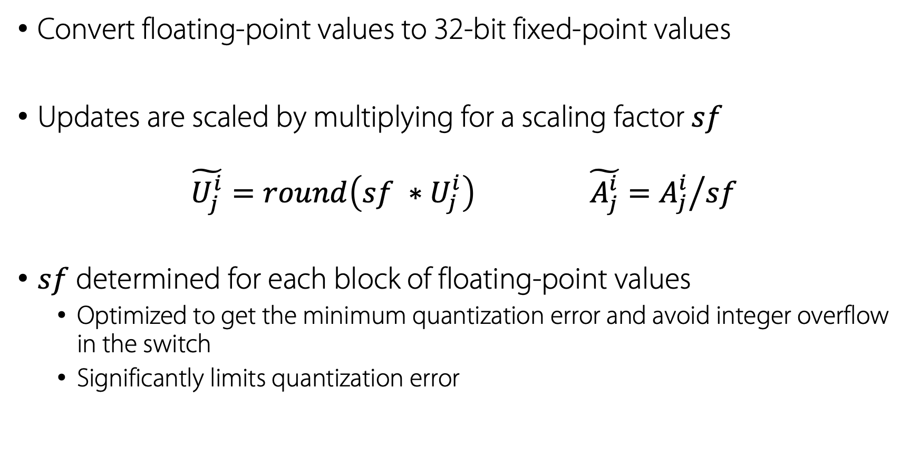
Block quantization
Convert floating-point values to 32-bit fixed-point values
Updates are scaled by multiplying for a scaling factor $sf$
$$\tilde{U_{j}^{i}}=round\left(sf ∗U_{j}^{i}\right) \tilde{A_{j}^{i}}={A_{j}^{i}}/{sf}$$
$sf$ determined for each block of floating-point values
Optimized to get the minimum quantization error and avoid integer overflow in the switch
Significantly limits quantization error

Slide 13
Dynamic scaling factor
Per-block scaling factor
Maximize range avoiding overflow
Lookahead to find the best scaling factor for the next block
The switch provides the max across workers
Aggregated packet
N
DE-SCALING
Tensor Update
MAX EXPONENT
MAX EXPONENT
SCALING
SCALING
Scaling factor ∝ 2^{N}
Outgoing packet
Outgoing packet

Slide 14
Dynamic scaling factor
Per-block scaling factor
Maximize range avoiding overflow
Lookahead to find the best scaling factor for the next block
The switch provides the max across workers
Aggregated packet
Quantization allows training to similar accuracy in a similar number of iterations as an unquantized network
N
DE-SCALING
Tensor Update
MAX EXPONENT
MAX EXPONENT
SCALING
SCALING
Scaling factor ∝ 2^{N}
Outgoing packet

Slide 15
Packet loss tolerance
Packet loss can happen in two directions
Workers detect losses using timers
Lost packets are retransmitted
A model update must not be applied twice
A model update must not be applied to a “full” slot
Workers contribution per-slot tracked with a bitmap
Ignores duplicates
Shadow copy of the previous result for a slot
Retransmits a dropped result packet

Slide 16
Packet loss tolerance
w1
w2
w3
w1
w2
w3
w1
w2
w3
w3
w3
(ignored)
(ignored)
(retransmission)
Aggregation
Result Distribution
Aggregation
Pool 0
1
2
000
3
3
100
110
111
011
3
000
000
111
001
Aggregation
Result Distribution
Time
Pool 1
000
111
3
100
110
111
0
1
3
2
w1
w2
w3
w1
w2
w3
Workers contribution per-slot tracked with a bitmap
Ignores duplicates
Shadow copy of the previous result for a slot
Retransmits a dropped result packet

Slide 17
Notation update
Slot: memory to store a packet-worth of elements
Pool: N slots
Pool index: metadata to select a slot in the pool
Version bit: metadata to select the pool
Switch memory: 2 pools of N slots
SWITCH
SLOT SELECTION
METADATA
UPDATE 1
UPDATE 2
UPDATE 3
UPDATE 4
UPDATE 5
UPDATE 6
UPDATE 7
UPDATE 8
…
+
+
+
+
+
+
+
+
+
Stage
Stage
Stage
Pool 0
Pool 1

Slide 18
Notation update
Slot: memory to store a packet-worth of elements
Pool: N slots
Pool index: metadata to select a slot in the pool
Version bit: metadata to select the pool
Switch memory: 2 pools of N slots
SWITCH
SLOT SELECTION
METADATA
UPDATE 1
UPDATE 2
UPDATE 3
UPDATE 4
UPDATE 5
UPDATE 6
UPDATE 7
UPDATE 8
…
+
+
+
+
+
+
+
+
+
Stage
Stage
Packet
slot
Stage
Pool 0
Pool 1

Slide 19
How large a packet can a switch process?
256B of payload per packet → 75.7% network efficiency
Memory
ALU
Pipe 0
Pipe 1
Pipe 2
Pipe 3
Notes:
Given the limited amount of computational resources, there is a limit to the number of elements that a switch can process. We implemented SwitchML on an Intel Tofino switch, which implements a PISA architecture. This switching ASIC has 4 pipelines to process up to 6.5Tbps.
We found that each pipeline can process in one pass 256 Bytes of payload per packet. Given framing overhead, this results in a network efficiency of 75.7%.

Slide 20
How large a packet can a switch process?
1024B of payload per packet → 92.6% network efficiency
Pipe 0
Pipe 1
Pipe 2
Pipe 3
Notes:
SwitchML implements also a second strategy, based on chaining the pipelines together to process 1024 Bytes of payload per packet which provides 92.6% network efficiency, which is the maximum efficiency possible with RDMA on Ethernet without using jumbo frames.

Slide 21

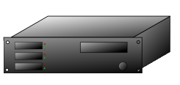
Multi-switch hierarchical aggregation
Aggregation phase
Distribution phase
∑
∑
∑
∑
∑
∑
∑
. . .
. . .

Slide 22





Implementation and evaluation
Switch program written for Intel Tofino
End-host C++ library providing a familiar all-reduce API
Integrated with ML frameworks
Standard ML benchmarks
Microbenchmarks for aggregation performance
Notes:
We implement SwitchML as a switch program written in P4 and an end-host library providing a familiar all-reduce API. We implemented 2 versions of this library, one using UDP and DPDK and the other using RDMA. We integrated this library with common ML frameworks such as Pytorch and Tensorflow through Horovod.
We evaluated switchML using standard ML benchmarks to measure training speedup and microbenchmarks to measure pure aggregation performance.

Slide 23
SwitchML software stack
SwitchML frontend
Pytorch / Tensorflow / Horovod
SwitchML server-side library
Drives the protocol
Multiple threads working in parallel with dedicated HW queues
FP conversion
Job setup via gRPC calls
P4 program
Process up to 256B of payload
Folded pipeline to process 1KB per packet
Controller
Job setup via gRPC
Benchmarks
NCCL
DPDK-UDP backend
RDMA UC backend
Pipe 0
Pipe 1
Pipe 2
Pipe 3

Slide 24
256 elements pipeline overview
Format RoCE packet
Egress pipe
Traffic manager
Exponents
Next Step
Next Step
Next Step
Next Step
ALUs
ALUs
ALUs
ALUs
Count workers
ALUs
Count workers
ALUs
Count workers
ALUs
Count workers
ALUs
Check for duplicates
Check for duplicates
Check for duplicates
Check for duplicates
Receive RoCE packet
Ingress pipe

Slide 25
General packet flow
harvest7
Format RoCE packet
harvest6
harvest5
harvest4
harvest3
harvest2
Traffic manager
harvest1
harvest0
SwitchML metadata
Exponents
Next Step
Next Step
Next Step
Next Step
ALUs
ALUs
ALUs
ALUs
Count workers
ALUs
Count workers
ALUs
Count workers
ALUs
Count workers
ALUs
Check for duplicates
Check for duplicates
Check for duplicates
Check for duplicates
Receive RoCE packet
data7: 128B
harvest7
harvest7
data7
harvest7
data7
harvest7
data7
harvest7
data6: 128B
harvest6
harvest6
data6
harvest6
harvest7
data6
harvest6
data6
SwitchML metadata
data5: 128B
harvest5
harvest5
data5
harvest5
harvest6
data5
SwitchML metadata
SwitchML metadata
data4: 128B
harvest4
harvest4
data4
harvest4
harvest5
data4
harvest7
data3: 128B
harvest3
harvest3
data3
SwitchML metadata
harvest4
SwitchML metadata
harvest6
data2: 128B
harvest2
harvest2
data2
harvest3
harvest5
data1: 128B
SwitchML metadata
harvest1
SwitchML metadata
SwitchML metadata
SwitchML metadata
data0: 128B
SwitchML metadata
RoCE, UDP, IP, Eth

Slide 26
Session setup
gRPC
Controller
1. Setup
1. Setup
BF-Runtime
WORKER
WORKER
SW
NIC
NIC
SW
2. WRITE
QP
QP
2. WRITE
WRITE
WRITE
2. WRITE
QP
WRITE
WRITE
QP
2. WRITE
2. WRITE
QP
QP
2. WRITE
2. WRITE
QP
QP
2. WRITE

Slide 27
Client APIs
Setup
1. 2. 3.
#include <switchml/context.h>
switchml::Context& ctx = switchml::Context::GetInstance();
ctx.Start();
Cleanup
ctx.Stop();

Slide 28
Client APIs - Synchronous
Allreduce
ctx.AllReduce(in_ptr, out_ptr,
number_of_elements, switchml::FLOAT32, switchml::AllReduceOperation::SUM);
Data type and operation enums
enum DataType {
FLOAT32,
INT32,
};
enum AllReduceOperation {
SUM,
};

Slide 29
Client APIs - Asynchronous
Allreduce
std::shared_ptr<switchml::Job> handle = ctx.AllReduceAsync( in_ptr, out_ptr, number_of_elements, switchml::FLOAT32, switchml::AllReduceOperation::SUM);
Test job status
if (handle->GetJobStatus() == switchml::JobStatus::FINISHED)
Wait for completion
handle->WaitToComplete();
ctx.WaitForAllJobs();

Slide 30
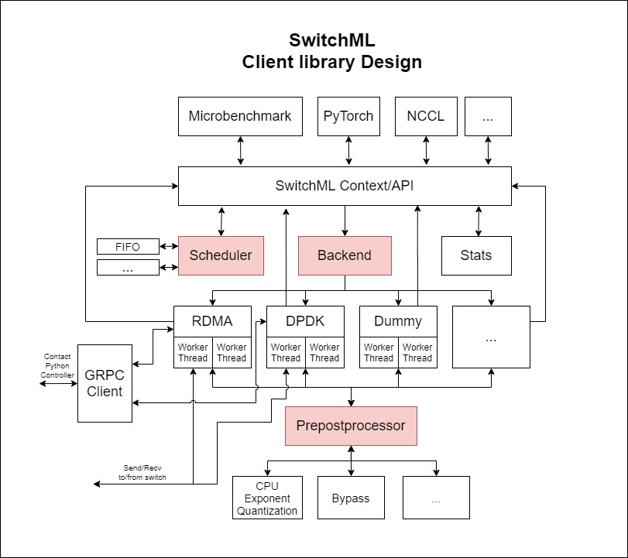
Extensible Client-side Design
Backend
RDMA
DPDK
DUMMY
Yours?
Prepostprocessor
CPU Exponent Quantizer
Bypass
Yours?
Scheduler
FIFO
Yours?

Slide 31
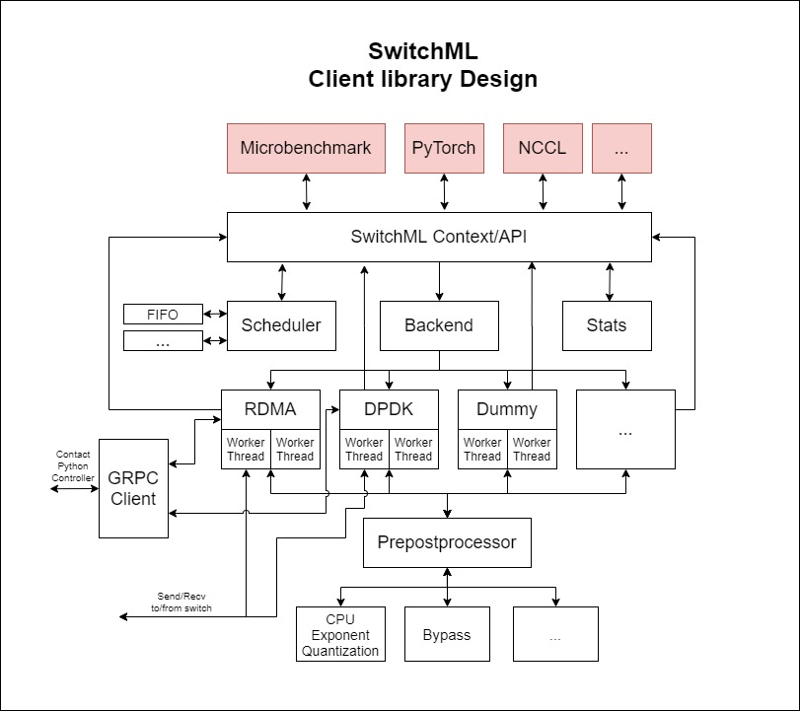
Extensible Client-side Design
Implement your own idea in SwitchML
Use SwitchML’s microbenchmark to test it.
Use SwitchML frameworks integration to test it with PyTorch, NCCL..etc.

Slide 32
Evaluation

Slide 33
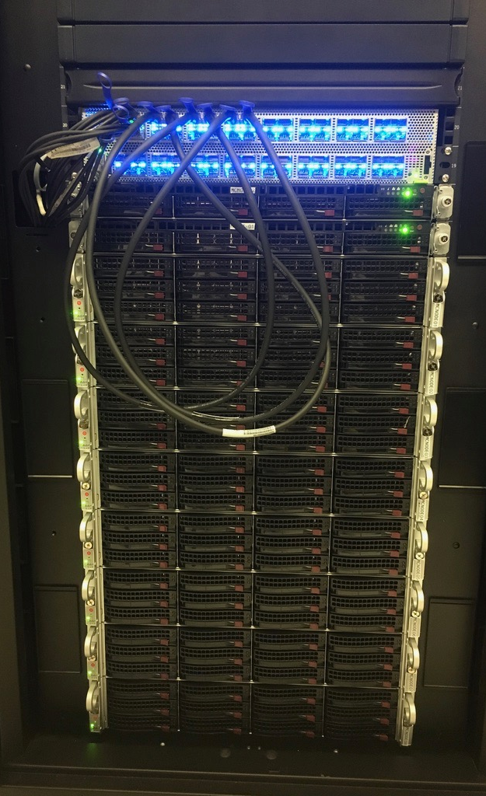
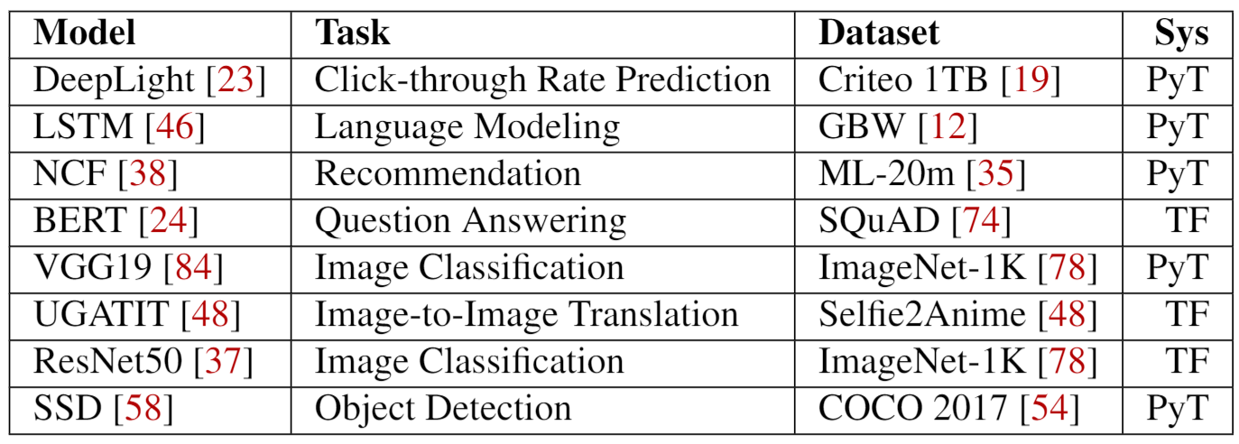
Evaluation
Testbed:
16 servers (8 w/ P100 GPUs)
100 Gbps Mellanox Connect-X 5
64 x 100 Gbps Wedge switch (Tofino)
Models:
8 DNN benchmarks

Slide 34
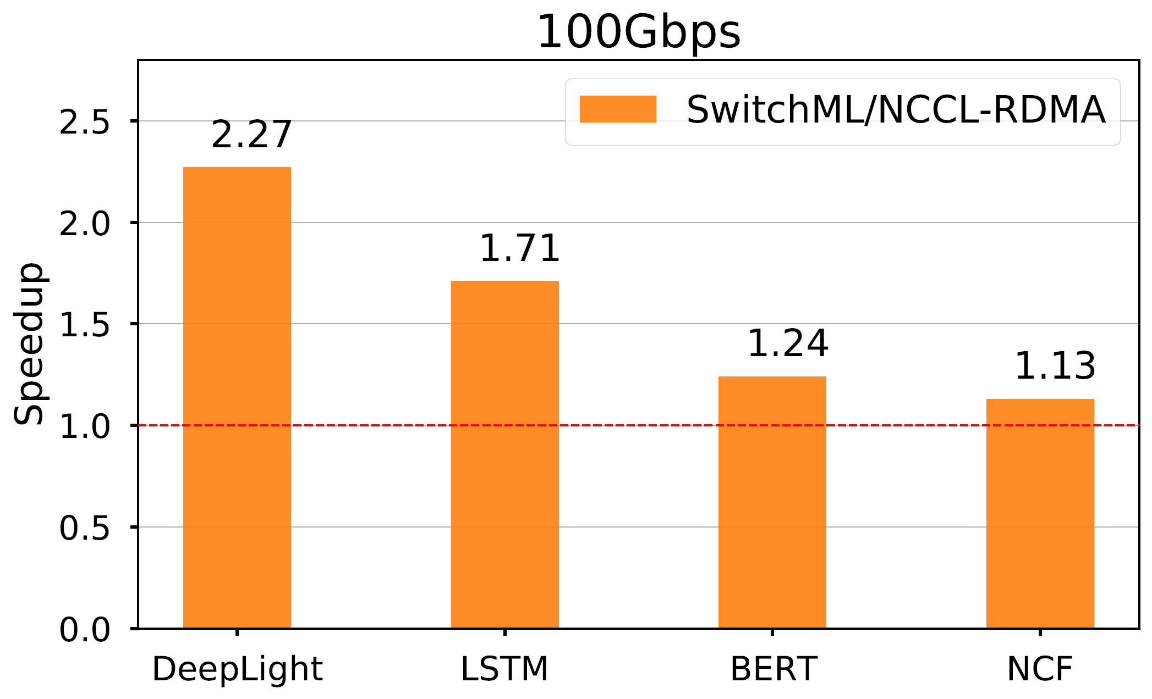
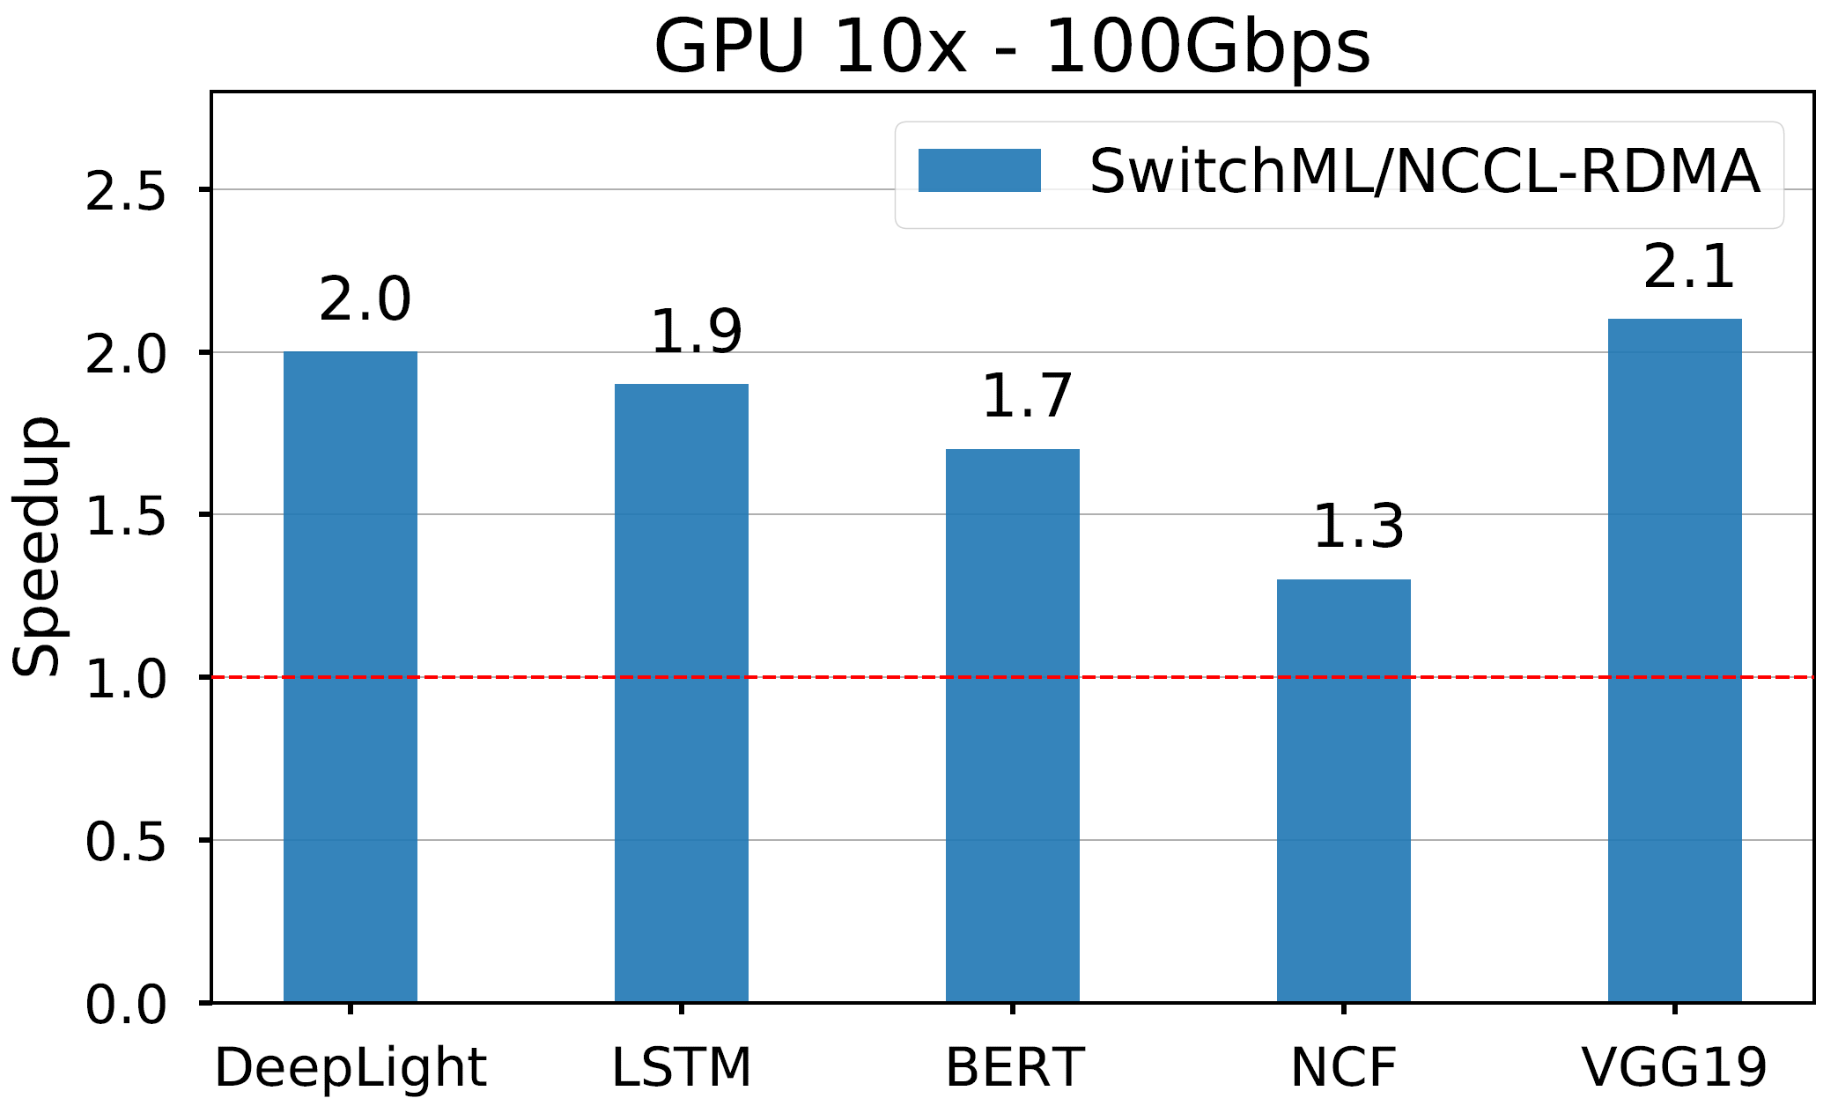
How much faster is SwitchML?
SwitchML provides a speedup in training throughput up to 2.27x on 100Gbps networks.
Speedup is higher with faster GPUs that reduce the computation/communication ratio.
Notes:
We measured the speedup that switchML provides when training different models on an 8 nodes and 8 GPUs testbed compared to NCCL-RDMA, which is the framework commonly used for these workloads.
Here I am showing results on a 100Gbps network, but the speedups are even large with slower networks. On the left you can see that SwitchML can provide speedups between 1.13x to 2.27x depending on the model, since different models have a different computation/communication ratio. In this experiments we are using UDP and DPDK, and we expect to get even better performance with RDMA.
We also expect even larger improvements with faster GPUs. We simulated training with a 10 times faster GPU and we have seen that, for most models, the reduction in computation time leads to even higher speedups.

Slide 35
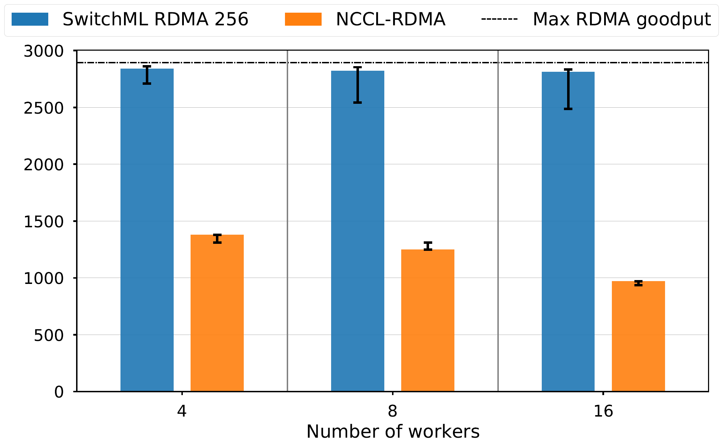
How does SwitchML scale with the number of workers?
SwitchML performance does not depend on the number of workers.
Millions of Aggregated Tensor Elements per second
Notes:
We also wanted to measure how SwitchML scales with the number of workers. We performed a microbenchmark experiment with 4,8 and 16 workers. Here I am showing as a metric the number of aggregated elements per second and we saw that SwitchML performance does not depend on the number of workers, differently from the allreduce approaches, such as NCCL.

Slide 36
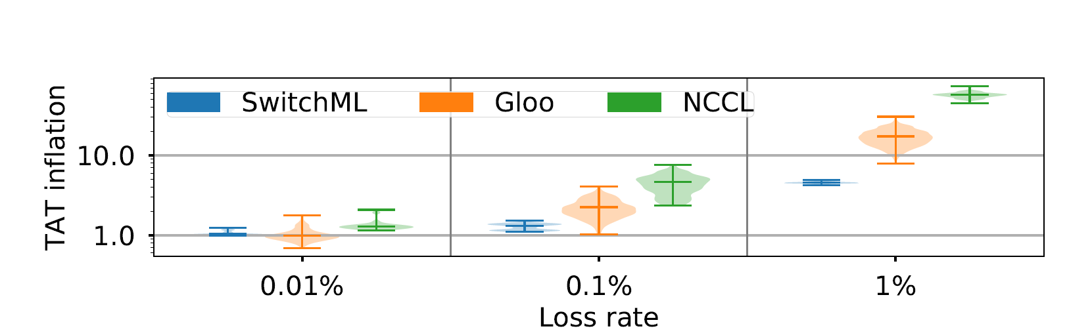
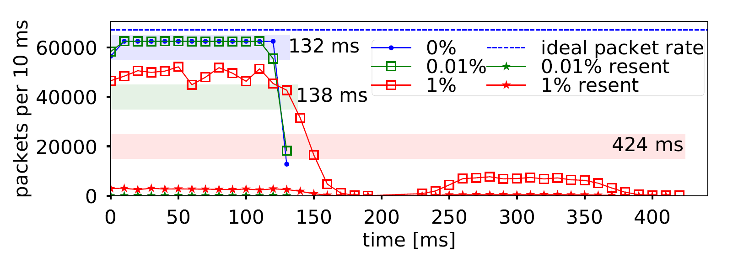
How does SwitchML fare with packet losses?
SwitchML has a lower inflation than TCP
Reasonable packet loss rates have no impact on performance

Slide 37
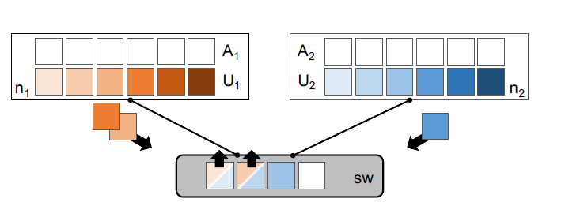
Summary
Use in-network aggregation to synchronize model parameters updates
Reduce network traffic volume and latency
SwitchML speeds up training up to 2.27x with real-world DNN benchmarks
Aggregation time does not depend on the number of workers
∑
github.com/p4lang/p4app-switchML
Notes:
To summarize, SwitchML performs in-network aggregation to synchronize model parameters updates, reducing both traffic volume and latency. We observed speedups up to 5.5x over NCCL-TCP and 2.3x over NCCL-RDMA with real-world benchmarks and showed that with SwitchML aggregation time does not depend on the number of workers, so it is more beneficial with large testbeds.
We are sharing the SwitchML implementation as an open source project under the P4-apps working group of P4.org and we invite everyone to use it and contribute.

